Slide 1
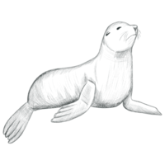
NOAA Fisheries Steller Sea Lion Population Count
06.2025
Lam Kin Ho
Chih-Jou Huang
Dong-You Tsou
Ping-Yeh Chou

Slide 2
Table of Contents
01
02
03
Introduction
Related
Works
Proposed Approaches
04
05
Experimental
Setup
Conclusions

Slide 3
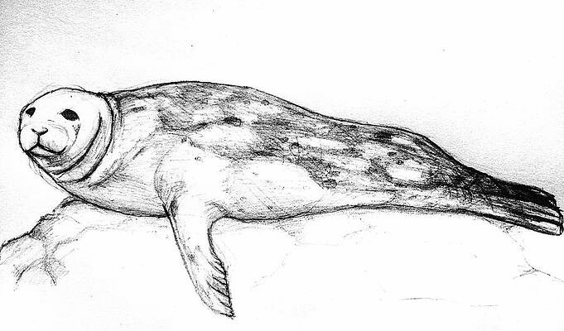
01
Introduction

Slide 4
Why Counting Steller Sea Lions
Population Crisis:
Steller sea lion numbers have drastically declined in the western Aleutian Islands
Conservation efforts are urgent and require accurate population data.
Challenges in Manual Counting:
Requires highly trained personnel.
Time-sensitive and resource-intensive.
Significance of Accurate Estimates:
Critical for understanding population dynamics.
Informs and improves conservation strategies.
Helps identify recovery barriers in specific regions

Slide 5
Automating Counting Process
Motivation:
Reduce dependency on manual labor.
Increase monitoring frequency and area coverage.
Improve reliability and scalability of population estimates.
Difficulties in Existing Approaches:
Detection-based: struggle with overlapping animals, result in missed counts.
Segmentation-based: sensitive to segmentation noise, unstable counts.
Our Contribution:
Introduce YouCount: a YOLO11-based counting method.
Propose ABC Framework: improves annotation with adaptive bounding boxes.
Achieved 1st runner up in Kaggle competition, RMSE: 11.65
Provide full implementation at publicly available GitHub: https://anonymous.4open.science/r/Counting-Sea-Lions-6E98

Slide 6
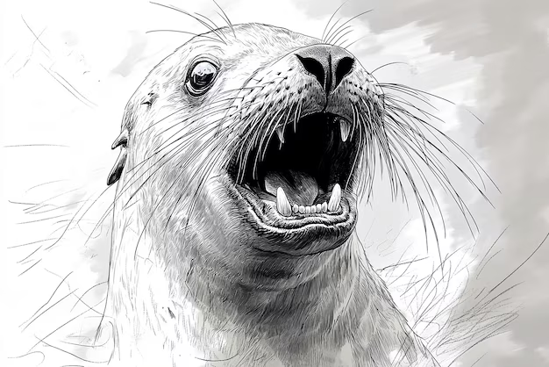
02
Related Works

Slide 7
Annotation Methods
High-Level Description:
NOAA dataset uses colored dots to mark different sea lion categories.
Existing methods convert dots to:
Fixed-radius circles (Segmentation)
Fixed-size squares (Detection)
Limitations of Traditional Annotation:
Size uniformity issue:
Ignores sea lion size variation → inaccurate representation
Shape mismatch:
Sea lions ≠ perfect circles/squares → masks poorly approximate true shape
Overlapping regions:
Dense clusters lead to overlapping annotations → confusion in model training

Slide 8
Counting Methods
High-Level Description:
Object Detection (e.g., Fast-RCNN, ResNet)
Pros:
Provides bounding boxes and confidence scores
Works well in moderate density areas
Cons:
Overlap in crowded images causes bounding box confusion
Sensitive to image scale and perspective variations
Instance Segmentation (e.g., UNet)
Pros:
Better handles overlap than detection methods
More accurate shape modeling with masks
Cons:
Center-point estimation errors due to posture variation
Segmentation instability affects counting precision

Slide 9
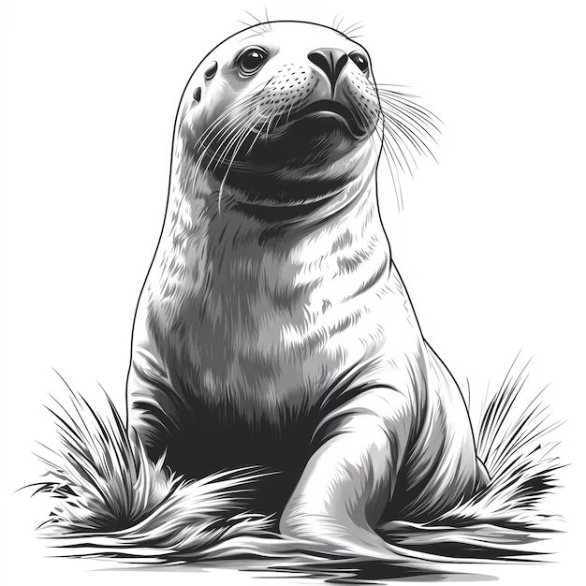
03
Proposed Approaches

Slide 10
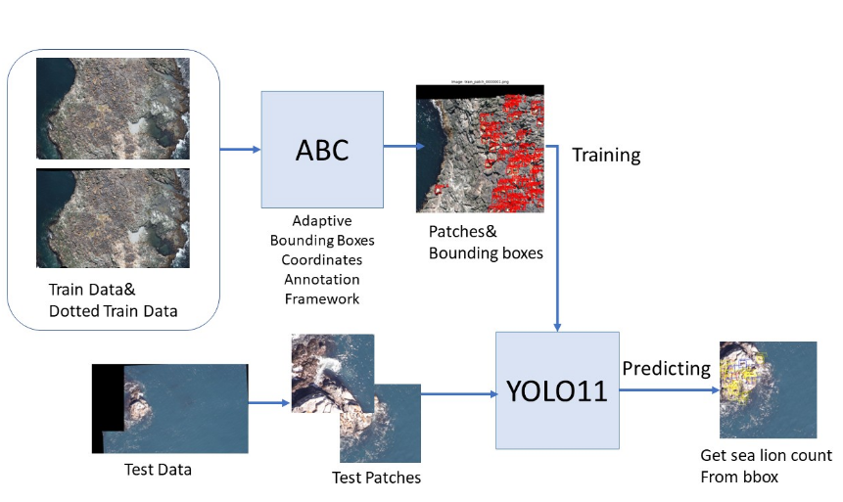
Overview
Combines adaptive annotation and object detection.
Two main components:
ABC (Adaptive Bounding Box Annotation Framework)
YouCount (YOLO-based counting model)
Supports robust sea lion localization in complex aerial imagery.
Incorporates pre-processing, patching, training, and post-processing.

Slide 11
Adaptive Bounding Box (ABC)
Adaptive Bounding Box Generation:
Start with square bboxes centered on annotated dots.
Resize using IoU-based scaling & distance-aware directionality.
Prevent overly small boxes with min-size constraint.
Patch Extraction Strategies:
Overfitting-Based Patching:
Randomly samples bbox-centered patches (30% of total).
Limits number of patches per image (1–3).
Tiling-Based Patching:
Slides a fixed-size window (stride = 95%) over image grid.
Enables dense coverage with overlap.
Patch Filtering:
Discard clipped bboxes (<20% original area).
Discard patches with >50% black pixels.
Downscale all valid patches from 1280 to 640 for YOLO input.

Slide 12
YOLO-Based Counting (YouCount)
Training Phase:
Input: annotated patches with bbox + class labels.
Model: YOLO11 with multi-scale detection.
Techniques: heavy data augmentation, learning rate scheduling.
Inference Phase:
Resize patches to 640×640 for YOLO.
Predict bboxes + class probabilities.
Apply Non-Maximum Suppression (NMS) to remove overlaps.

Slide 13
YouCount (Cont’d)
Count Refinement:
Edge-weighting rule:
Near 1 edge → ×0.7
Near 2+ edges → ×0.5
Reduces double-counting from overlapping patches
Post-Processing:
Apply category-wise scaling based on bias correction:
Pups ×1.3, Juveniles ×0.85, Adult Females ×0.96
Adult Males ×1.55, Subadult Males ×1.2

Slide 14
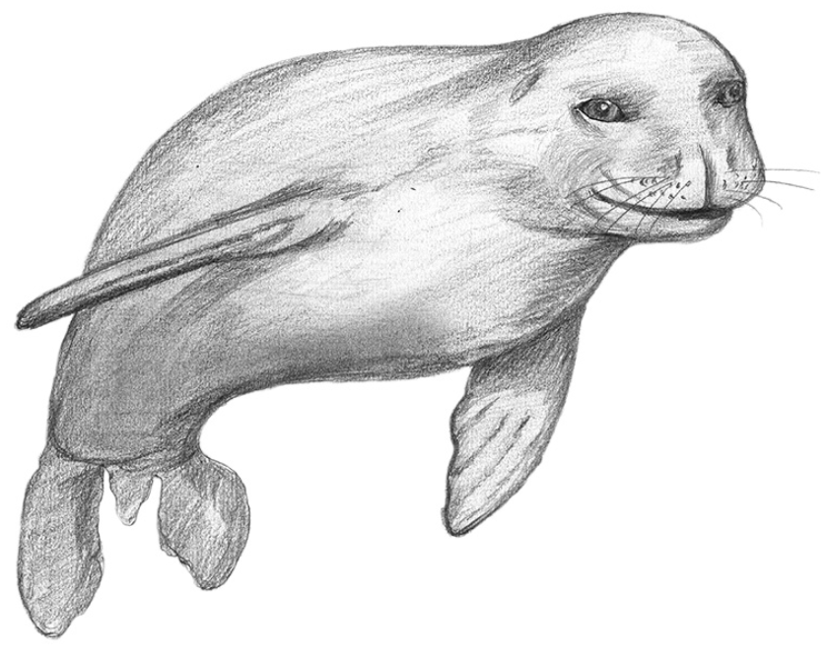
04
Experimental Setup

Slide 15
Dataset & Metrics
Dataset – NOAA Fisheries Competition:
Train/: 946 high-res images (raw images)
TrainDotted/: Annotated counterparts (colored dots)
Test/: Unlabeled test images
Goal: Count sea lions in 5 categories:
Adult Males, Subadult Males, Adult Females, Juveniles, Pups
Training Details:
Followed competition settings
Used ABC framework for annotation + YOLO-based model for detection
Evaluation Metric:
Root Mean Squared Error (RMSE):
Measures accuracy of predicted counts per image
Lower RMSE → better performance

Slide 16
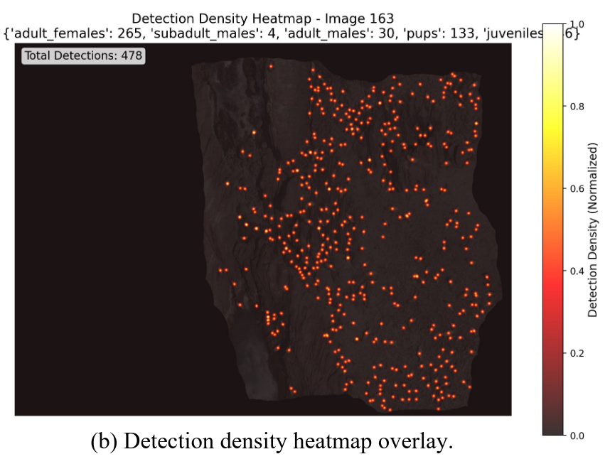
Experimental Results
Quantitative Results:
Public test RMSE: 11.68482
Private test RMSE: 11.63121
Strong generalization across both test sets
Qualitative Observations:
Detection in crowded scenes: Accurately separates overlapping sea lions
Small object detection: Can identify pups despite size and visual ambiguity
Spatial behavior: Heatmaps show focused detection; minimal false positives in ocean/background

Slide 17
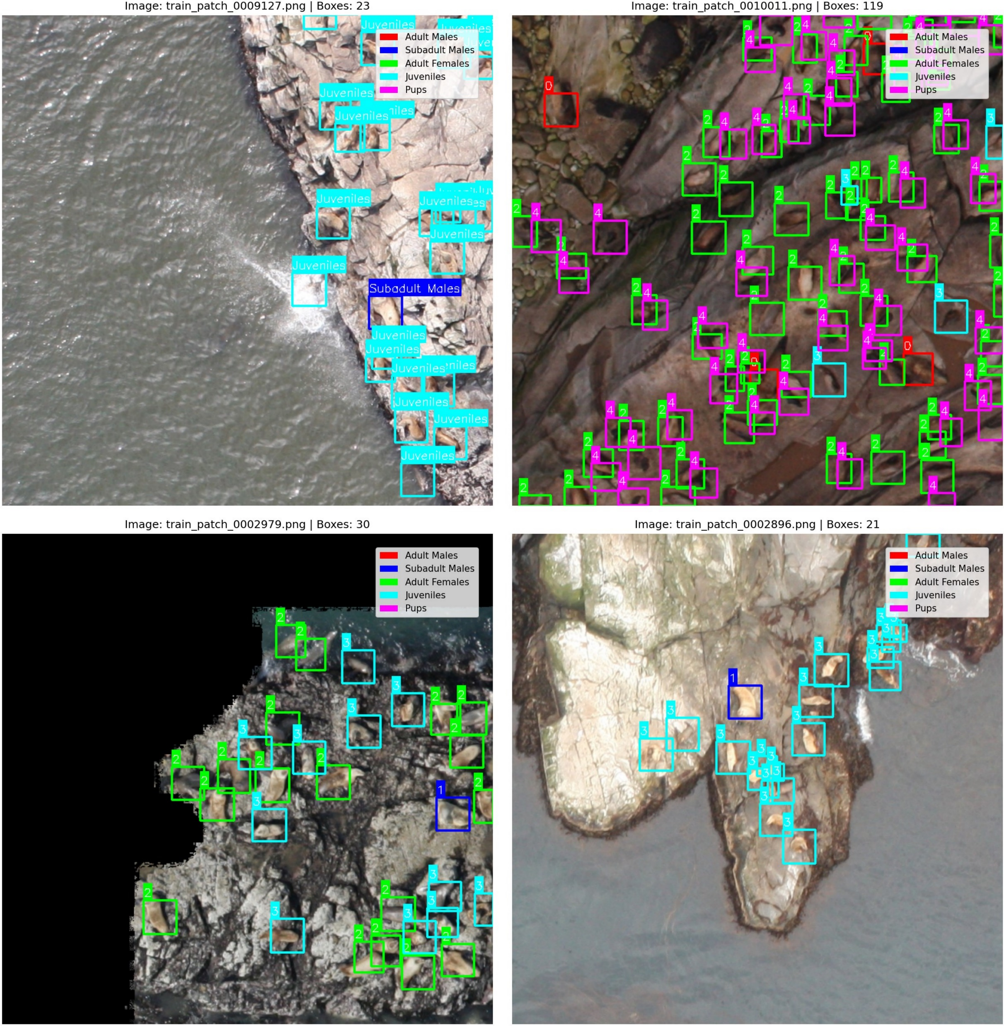
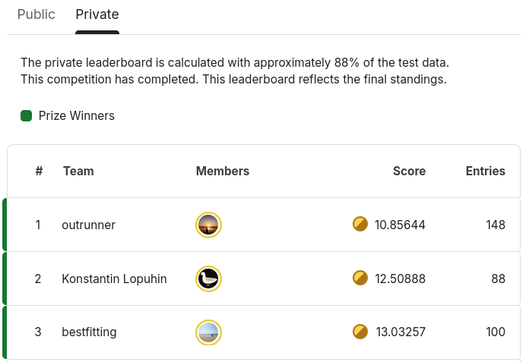
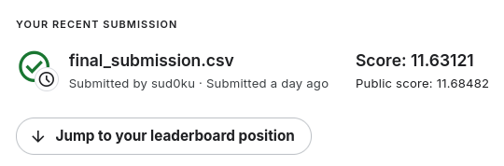
Results

Slide 18
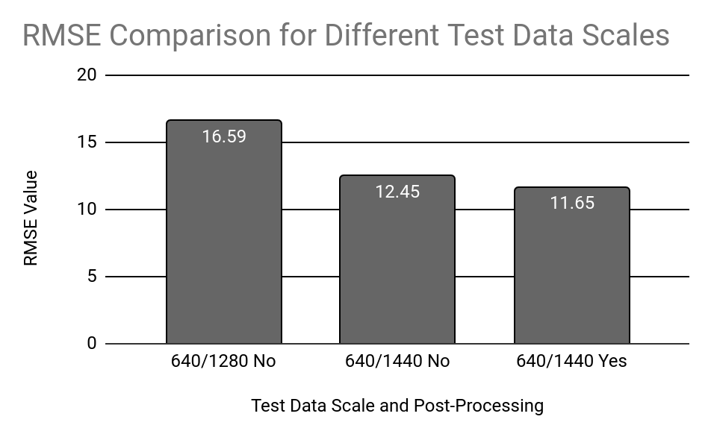
Ablation Studies
Experiment Variables:
Input Resolution: Testing larger crop sizes before downscaling
Post-Processing: Applying class-wise scaling to correct bias
Key Insights:
Higher patch resolution (1440) → +4.1 RMSE improvement
→ Better matches sea lion scale between train and test images
Post-processing (class scaling) → +0.8 RMSE improvement
→ Helps correct systematic class count biases
Hypothesis:
Larger initial crops preserve more detail
Category-wise scaling aligns predictions with true class distribution.
Conclusion:
Combining both changes leads to significant boost in accuracy (RMSE ↓ from 16.59 to 11.65)

Slide 19
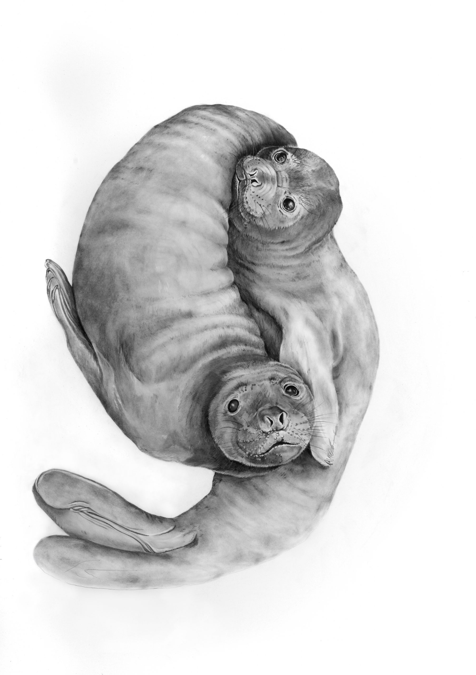
05
Conclusions

Slide 20
Conclusions
What We Did:
Proposed YouCount, an automated pipeline for counting Steller sea lions.
Introduced ABC Framework for adaptive, scale-aware annotations.
Employed dual patch generation strategies for robust data coverage.
Used YOLO11x with augmentation and post-processing to enhance detection and counting.
What We Achieved:
RMSE: 11.65312 on private test set — ranked 2nd in Kaggle competition.
Accurately detected sea lions in dense, overlapping, and varied conditions.
Demonstrated strong generalization and class-specific detection.
What We Learned:
Adaptive annotations significantly improve performance in crowded.
Patch resolution and post-processing greatly affect counting accuracy.
Combining detection stability with ecological domain knowledge leads to practical and scalable solutions.

Slide 21
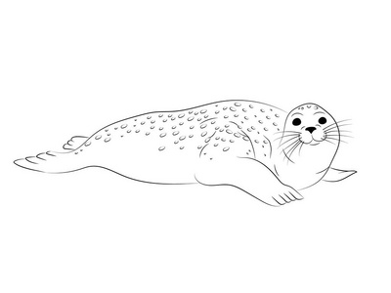
Thanks!
06.2025
Do you have any questions?

Slide 22
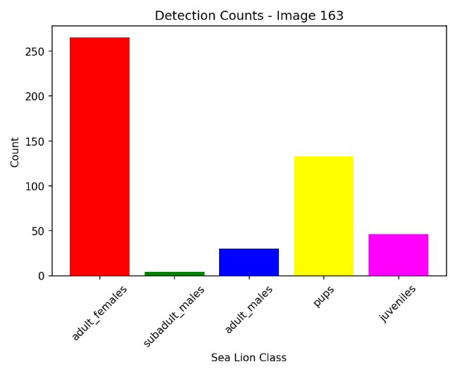
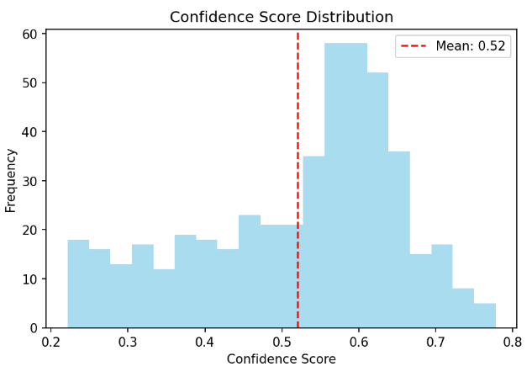
06.2025
Category Analysis:
Detection count: Adult females most common, subadult males rare
Confidence distribution:
Most detections between 0.5–0.65
Average confidence ≈ 0.52 → moderate certainty, some instability

